Slide 1
Software Architecture Assignment :1
 | Name | Email Address | ID Number
 | Mohammed Jubair Khan Mahen Jamal | 2019ht13292@wilp.bits-pilani.ac.in 2019ht13206@wilp.bits-pilani.ac.in | 2019ht13292 2019ht13206
 | Amit Kumar Singh | 2019ht13043@wilp.bits-pilani.ac.in | 2019ht13043
 | Deepanshu | 2019ht13177@wilp.bits-pilani.ac.in | 2019ht13177
BITS Pilani

Slide 2
Purpose of the system
Design CCS(Converged Charging System to enable telecommunication service providers to enable real time convergent charging capability on diversified mobile networks (2G/3G/4G/5G/VOLTE) using a unified platform.
The proposed solution supports Converged Charging for diversified business scenario like VR Entertainment, Drone Logistics, Autonomous Car, Smart Grid, Drone Aid, VR Education, 4K Live Video , Tele-Operated Driving, AR/VR Live Broadcast, Drone Surveillance..etc.

Slide 3
Key Requirements : Functional & Non-Functional
Functional requirements | Non functional requirements
Video API support multiple hosting platform. Store metadata against each video. If the subscriber in not logged in the client should not pass user id in the req. Video API should return all details related to video like format ,length, profile etc. For the premium video check for the authenticated paid subscriber and then return the data. If the content is public just return to any subscriber without checking the authentication. | API Response time within 0.1 seconds System should support million of request per sec. Automatic & Elastic Scaling Logging & Monitoring Security Maintainability Usablity

Slide 4
Utility Tree
Understanding business value & Impact on architecture
Quality attribute | Attribute refinement | Scenario | Business value | Architecture impact
Security | Integrity | The customer data should not be lost or tampered with by unauthorized people, including those working in the company (1) | High | High
Performance | Service Availability | System should support 99.999% Availability (5) | High | High
Usability | User Experience | Customer should be able to register/subscriber/un-subscribe offers using system UI using standard self guided workflow within 2 minutes, (3) | High | High
Usability | Correctness | System should charge customer accurately based on service usages. | High | High
Modifiability | Criteria specification | User should be able to modify package and service easily using system or 3rd party application channel. (4) | Medium | Medium
Interoperability | Notification | The system should send real time notification to the customer when he/she buy new package. (5) | High | Medium
Performance | Response time | System should be able to support 1000 CAPS. | Medium | High
Interoperability | Unified User Experience | System should be able to support 2G/3G/4G/5G services on single platform | High | High
Usability | Understanding user model | Customer should be able to query his/her call detail record (CDR), system should store & support the query of minimum 6 months CDR, query response should be less than 5 seconds.(2) | Medium | Low
Usability | Intuitiveness | Using SMS/Data service should be very easy (2) | High | Medium
Interoperability | User Experience | Customer should be able to use basic services (SMS/Data) from different network, call connection delay should less than 100 millisecond (5) | High | High
Usability | Understanding user model | Customer should be able to choose and set offer Plans, Consumption limit using system or 3rd party system integrated by API (2) | High | Low
Usability | Status notification | Customer should be notified when number is activate, barred or suspended (2) | High | Medium
Performance | Scalability | System should support Millions of Connections considering 5G connectivity from all kind of devices (2) | High | High

Slide 5
Utility Tree
Understanding business value & Impact on architecture
Quality attribute | Attribute refinement | Scenrario | Business value | Architecture impact
Maintainability | Easy Operation & Maintenance | System should support easy monitoring, alarms , deployment using micro service based architecture using Docker Container. | High | High
Security | Confidentiality | Customer personal data like email/password ..etc should be encrypted in database using standard algorithm(5) | High | Medium
Availability | Data backup | System should keep back up of complete system data including customer information , system configuration details, (3) | Medium | High
Testability | detecting failure modes | System should support auto/mock testing to reduces testing cost and efforts. (4) | Medium | Low
Availability | Data backup | solution supports databases and virtualization environments full backup or Differential incremental backup | High | Medium
Security | Operation & Maintenance | Manage and audit all system logs through a centralized log server | Medium | High
Security | Operation & Maintenance | Monitor all systems to find exceptions and attacks | Medium | High
Performance | Scalability | System should be able to Scale In/Out based on future business need. | Medium | High

Slide 6
Tactics used to achieve the top 3 ASRs : Security
Quality Attribute | Scenario (ASR) | Tactics
Security | The customer data should not be lost or tampered with by unauthorized people, including those working in the company (1) | No direct access database by any user, all system user can access backend data through system business process with respective access rights.
 |  | Web Service Interfaces will be authenticated with User/Password
 |  | Coding security includes security methods during programming of codes
 |  | Access security includes identification, authentication, authorization, access control, session control etc.
 |  | Block multi session login from different devices and session time out after 5 minute (default time) for system user.
 |  | Store data on a separate database server cluster and protect the server using an appropriate security zones using firewall technologies
 | Customer personal data like email/password ..etc should be encrypted in database using standard algorithm(5) | Encrypt critical and personal data using standard protocol Like DB user Password will be encrypted using SHA256 Algorithm, sensitive data of application like password AES 128 algorithm for encryption
 | Manage and audit all system logs through a centralized log server | Develop a centralized log monitoring module to audit the system, user logs.
 | Monitor all systems to find exceptions and attacks. | Communication security is to ensure the security of transmission through secure protocol and non-repudiation technologies like HTTPS/SSL.
 |  | Ensure the security of applications and database OS hardening
 |  | Separate different network traffic and control through the appropriate security zones depending on subnets and firewall technologies
 |  | Protect internal and external network connections through VPN tunnels
 |  | Develop a centralized log monitoring module to audit the system, user logs
Notes:
Security
The customer data should not be lost or tampered with by unauthorized people, including those working in the company (1)
No direct access database by any user, all system user can access backend data through system business process with respective access rights.
Web Service Interfaces will be authenticated with User/Password
Coding security includes security methods during programming of codes
Access security includes identification, authentication, authorization, access control, session control etc.
Block multi session login from different devices and session time out after 5 minute (default time) for system user.
Store data on a separate database server cluster and protect the server using an appropriate security zones using firewall technologies
Customer personal data like email/password
..etc should be encrypted in database using standard algorithm(5)
Encrypt critical and personal data using standard protocol Like DB user Password will be encrypted using SHA256 Algorithm, sensitive data of application like password AES 128 algorithm for encryption
Manage and audit all system logs through a centralized log server
Develop a centralized log monitoring module to audit the system, user logs.
Monitor all systems to find exceptions and attacks.
Communication security is to ensure the security of transmission through secure protocol and non-repudiation technologies like HTTPS/SSL.
Ensure the security of applications and database OS hardening
Separate different network traffic and control through the appropriate security zones depending on subnets and firewall technologies
Protect internal and external network connections through VPN tunnels
Develop a centralized log monitoring module to audit the system, user logs

Slide 7
Tactics used to achieve the top 3 ASRs : Performance
Quality Attribute | Scenario (ASR) | Tactics
Performance & Scalability | The system should send real time notification to the customer when he/she buy new package | Design south bound integration using Elastic Load Balancer 99.999% Availability based on Distributed Architecture and Active-Active GDR
 | System should be able to support 1000 CAPS | New Services Deployed as Add-ons in separate container using service based architecture (SBA) complaint to 3GPP standard.
 | System should support Millions of Connections considering 5G connectivity from all kind of devices (2) | Session Control and Routing Service Separated from Session Control and Routing Database Cluster All Routing Service Nodes and Routing In-memory Database Nodes are Active Distributed DB and In-Memory DB Improve X Capacity and Performance
 | System should be able to Scale In/Out based on future business need within 1 day. | Fully Micro-service Based Architecture to support Auto service Scaling In/Out. Container: support seconds Scale In/Out, 90% Computing Resource savings

Slide 8
Tactics used to achieve the top 3 ASRs : Interoperability
Quality Attribute | Scenario (ASR) | Tactics
Interoperab ility | The system should send real time notification to the customer when he/she buy new package | Develop SMS adapter which can adapt different protocol like Integrate SMS sender module with SMSC on standard protocol to support different network.
 | Customer should be able to use basic services (Voice/SMS/Data) from different network, call connection delay should less than 100 millisecond | Develop separate module Diameter Gateway using micro service container.
 | System should be able to support 2G/3G/4G/5G services on single platform | Develop API gateway for 5G charging and use “Signal Access Point” for legacy 2/3/4G network.

Slide 9
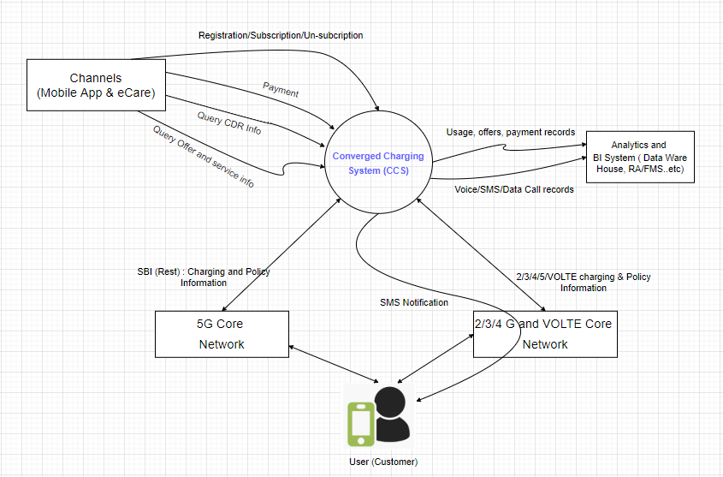
System Context Diagram
Legends
RA : Revenue Assurance FMS : Fraud Management BI : Business intelligence

Slide 10










Module Decomposition Diagram
Legends
Converged Charging System
DB: Database
API : Application programming interface SBI : Service based interface
BP : Business Platform
Remarks: Design Data Access Layer to support multi database using
DAF : Data Access Function DAS : Data Access Service
Adapter
Rating Engine
container
container container
container
container
container container
Chagrin Gateway
Usage Charging
Policy Charging
…
Digital Monitoring & Deployment
Business Platform (BP)
API Gateway
File Adapter
DCC Adapter
Voice Charging
Data Charging
ZooKeeper Service
Data Access Layer
SMS ChargMngmei ory DB Physical DB
Elastic Load balancer
…

Slide 11


Channels
Portal | CRM | Self Care | Mobile AP….
Portal | CRM | Self Care | Mobile AP….
Northbound Offline
Online
Notification
SOAP/Rest
Management
Operations
Dig_{ig}it_{i}a_{ta}l _{l}Monit_{i}o_{to}r_{r}in_{in}g & Deplo_{lo}yment_{t}
API_{I}Gate_{te}way
HTTPS
Busin_{in}ess Pla_{la}tf_{t}o_{fo}r_{r}m (₍BP)₎
Data ware House
SNMP
Rest
Rest
Data ware
House
RA/FMS
RA/FMS
ZooKeeper_{r}Ser_{r}vic_{ic}e
Poli_{l}c_{ic}y Char_{r}gin_{in}g
Physic_{ic}al _{l}DB
BI System
Chagr_{r}in_{in}Gate_{te}way
Char_{r}ge Data_{ta}Recor_{r}d Ser_{r}vic_{ic}e
Ela_{la}sti_{t}c_{ic}Load Bala_{la}ncer_{r}
Cache Ser_{r}vic_{ic}e
Rest
SMPP
Gy
Sy
5GCore
VAS
LTECore
SMF & PCF
SMSC
GGSN/PGW
PCRF

Slide 12











Deployment diagram
Portal | CRM | Self Care | Mobile AP….
Portal | CRM | Self Care | Mobile AP….
Firewall
Software Load Balancer (SLB)
Component | High Availability mode | Working mode
ELB | Distributed cluster | Master-Active
API Gateway | Distributed cluster | Active-Active
ZooKeeper | Distributed cluster | Master-Active
SMS Adapter | Dual | Active-Standby
Rating Engine | Distributed cluster | Active-Active
Charging Gateway | Distributed cluster | Active-Active
Policy Charging | Distributed cluster | Active-Active
Cache Service | Distributed cluster | Active-Active
BM | Distributed cluster | Active-Active
SLB | Dual | Active-Standby
Physical DB | Dual | Active-Standby
Memory DB | Dual | Active-Standby
Digital Monitoring & Deployment | Distributed cluster | Active-Standby
Container
API Gateway (To build, orchestrate, govern and maintain macro-APIs).
Rest
Rest
Service Bus
container container container _{container}
container
Business Platform (BP)
Adapter
Rating Engine
File Adapter
SMS Adapter
Voice Charging
Data Charging
SMS Charging
Service _{Service}
Service Service
Service
Usage Charging
Policy Charging
…
Digital
Monitoring & Deployment
Chagrin Gateway
ZooKeeper Service
Rest/File
Raw
_{CDR} Sy/Gy SBI DAF
DAS
Firewall
Data Access Layer (Cluster)
Elastic Load balancer (ELB)
Memory DB Physical DB
…

Slide 13
Top 3 Key Learnings
Mohammad Jubair Khan - 2019HT13292
To be update……

Slide 14
Top 3 Key Learnings
XXXXX - YYYY
To be updated by team members …… [ask them to update tomorrow]

